Slide 1
Planning and Management of Start-ups
Ilab Germinate Program
29th April 2013
Brian Ruddle Ph: 07 3716 2977 Fax: 07 3716 2999 Mob: 0407 169979 E-mail: brian@rudco.com.au

Slide 2
Presentation Outline
Why Management is Important
Management Tools
Stages
Initiation
Planning
Execution
Monitoring and controlling
Grant Management

Slide 3
Management Styles
Differ based on operation needs
Early Stage Operations – uncertain, require flexibility, need responsiveness, few resources, high risk
Mature Operations - repetitive, permanent, or semi-permanent functional activities to produce products or services
The management of these two systems is often quite different.

Slide 4
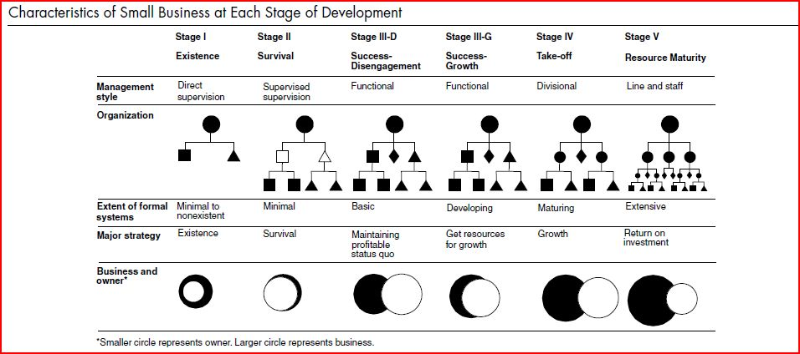
Management Skills at Different Stages
http://frrl.wordpress.com/2009/09/19/accidental-entrepreneurs-the-evolution-of-a-small-business/

Slide 5
Importance of Project Approach
Early Stages
Later Stages
Project 1
Project 2
Start-up
Project 1
Project 2
Established
Company

Slide 6
Management Challenges
To identify the real problems and alternate solutions
To ‘solve’ the problem in a complex and changing environment
To achieve the desired outcomes in a resource poor environment:
Personnel
$
Time
Planning and management should not stifle creativity

Slide 7
Presentation Outline
Why Management is Important
Management Tools
Stages
Initiation
Planning
Execution
Monitoring and controlling
Grant Management

Slide 8
Planning and Management Software
Collaborative software
Issue tracking system
Scheduling
Project Portfolio Management
Resource Management
Document Management
Workflow system
Reporting and Analyses
Look for software that is used in your industry
Make sure it is working for you and you are not working for it!

Slide 9
http://en.wikipedia.org/wiki/Comparison_of_project_management_software

Slide 10
Simple Planning Tools
Documentation of the objective/s (milestones) and activities
Documentation of the resources
Documentation of activity timeframes
Documentation of the budget
Documentation of risk management
Monitoring process
How you execute implementation is up to you!

Slide 11
Presentation Outline
Why Management is Important
Management Tools
Stages
Initiation
Planning
Execution
Monitoring and controlling
Grant Management

Slide 12
Initiation
What do you want to achieve and by when? (Aim high)
What is stopping you from achieving your goals and objectives? (real problems – ask ‘what causes that’)
What don’t you know?
Can use strategic planning frameworks:
SWOT
Porter five forces
Delta model etc.
Prioritise the problems or gaps in your knowledge and work out which ones are the most critical to achieving your goals/objectives
Can’t solve all problems

Slide 13
Example
I don’t know if the market wants ‘Widget 1’
I don’t know how much it will cost to create ‘Widget 1’
I don’t know what the market will pay
I am not sure of the regulatory requirements
I am not sure what competitors are out there and how I am different
Etc.

Slide 14
Presentation Outline
Why Management is Important
Management Tools
Stages
Initiation
Planning
Execution
Monitoring and controlling
Grant Management

Slide 15
Planning and Design
What is your goal (remember to aim high)
What are your objectives to achieve your goal
Identify the activities needed to complete the objectives
Check that the activities occur in a logical sequence
Estimate the resource requirements for the activities
Develop the implementation schedule (timing of activities)
Develop the budget (cost of resources to implement activities)
Risk planning

Slide 16
Group Exercise 1 – Planning and Design
A problem: I don’t know if the market wants ‘Widget 1’
What is your objective ? (To solve the problem)
What activities do you need to undertake to achieve the objectives? (If I complete all steps will I achieve my objective)
What resources are required? (who, what, where, when)
What is the cost of those resources?
When should they occur?

Slide 17
Developing a Risk Matrix
Risk
Impact if Risk Occurs
L
C
Risk Management
Responsibility / Timing
L – Likelihood (5=almost certain, 4=likely, 3=possible, 2=unlikely, 1=rare)
C- Consequence (5=severe, 4=major, 3=moderate, 2=minor, 1=negligible)

Slide 18
Group Exercise 2 - Risks
Review risk categories
Thinking of your entire venture:
Mark the risk categories that could stop you achieving one of your objectives

Slide 19
Presentation Outline
Why Management is Important
Management Tools
Stages
Initiation
Planning
Execution
Monitoring and controlling
Grant Management

Slide 20
Executing
The Manager (project leader):
the person accountable for accomplishing one or more objectives
managing the triple constraint for projects, which is cost, time and scope
Communication
Team management
Managing the unexpected
Reporting on outputs and outcomes

Slide 21
Presentation Outline
Why Management is Important
Management Tools
Stages
Initiation
Planning
Execution
Monitoring and controlling
Grant Management

Slide 22
Monitoring and Controlling
Assessing the status of the activities (Where are we)
Monitoring the variables (cost, effort, scope, etc.) against the implementation plan (Where we should be)
Identify corrective actions to address issues and risks (How can we get on track again)
Be Flexible
Don’t lose sight of the end goal!

Slide 23
Monitoring Framework

Slide 24
Monitoring Tips
Keep it simple
Recognise road blocks early
Keep refocussing:
Is the objective still important
Is the activity still important
Does a risk need to be dealt with now
Don’t be afraid to keep timelines tight
Parkinson's Law (Work expands so as to fill the time available for its completion)
Resource burn - $ and people

Slide 25
Presentation Outline
Why Management is Important
Management Tools
Stages
Initiation
Planning
Execution
Monitoring and controlling
Grant Management

Slide 26
Grant Projects
Same process applies:
Objectives (milestones)
Activities to achieve objectives
Resources to achieve activities
Timeline
Budget
Monitoring and reporting
Turning inputs to outputs to outcomes

Slide 27
Information Sources
http://frrl.wordpress.com/2009/09/19/accidental-entrepreneurs-the-evolution-of-a-small-business/
http://en.wikipedia.org/wiki/Project_management
http://www.smallbiz.nsw.gov.au/start/legalcompliance/riskmanagement/categories/Pages/default.aspx
http://en.wikipedia.org/wiki/Comparison_of_project-management_software

